Slide 1

Master in Computational Data Science
Enhancing the methodological approach to Systematic Literature Reviews: A practical application on Topic Labeling research
Candidate: Samuele Ceol
Supervisor: Barbara Russo
July 2023

Slide 2
Rationale & Research questions
Addressing the lack of SLRs on topic labeling
Reviewing the relevant primary studies in the period 2017-2022
Providing a set of methodological contributions
Stemming from observations made throughout the review process
Enhancing (parts of) existing guidelines for secondary studies
Believed to be generally applicable outside of the investigated domain
Research questions seek to explore the domain of interest in terms of:
Identified cateogories of labeling approaches and techniques by which they are implemented
Topic modeling methods used to generate the distributions
Observed label structures and conducted label selection and quality evaluation procedures
Characteristics of the underlying corpora

Slide 3
Definitions
Topic modeling: “a text mining […] method that extracts topics from large corpora of textual documents to discovery hidden [i.e. latent] semantic structures in text” -Silva et al. (2021)
Topic: A probability distribution over a fixed vocabulary (often represented via the most prominent terms)
Topic labeling: Task of pairing each topic with a label capable of concisely summarising its content
Topic label: “a sequence of words which is semantically meaningful and covers the latent meaning of the topic. Words, phrases, and sentences are all valid labels under this definition” - Mei et al. (2007)
Example:
Topic terms: vote, house, election, poll, bill, republican, party, voter, candidate, senate, …
Label: election
Notes:
Topic model: Probabilistic\Statistical models that exploit the correlation among words to discover hidden [latent] structures -> Topics

Slide 4
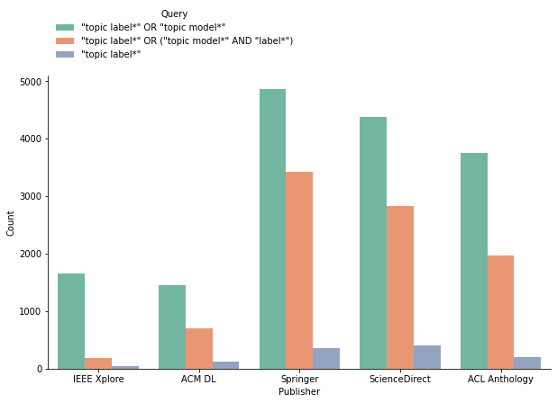
Venue selection process
Exploratory search is conducted on 5 repositories:
IEEE Xplore, ACM Digital Library, SpringerLink, ScienceDirect & ACL Anthology
Three queries proposed for this purpose
Ultimately, one is selected to gather the relevant venues
, each yielding a set of numerical results

Slide 5
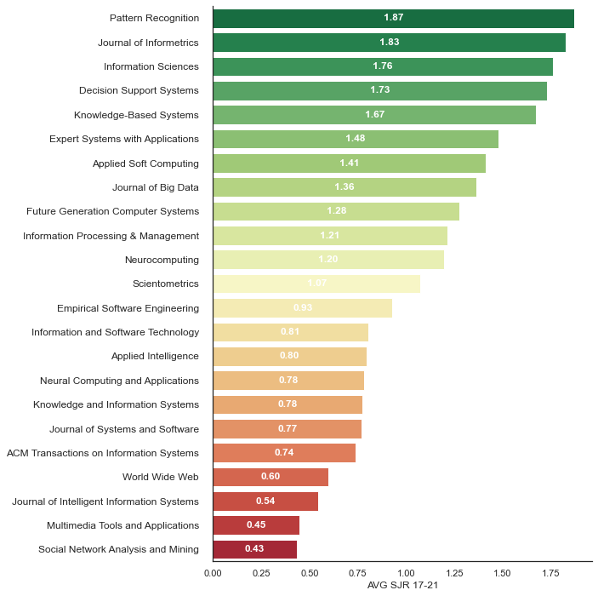
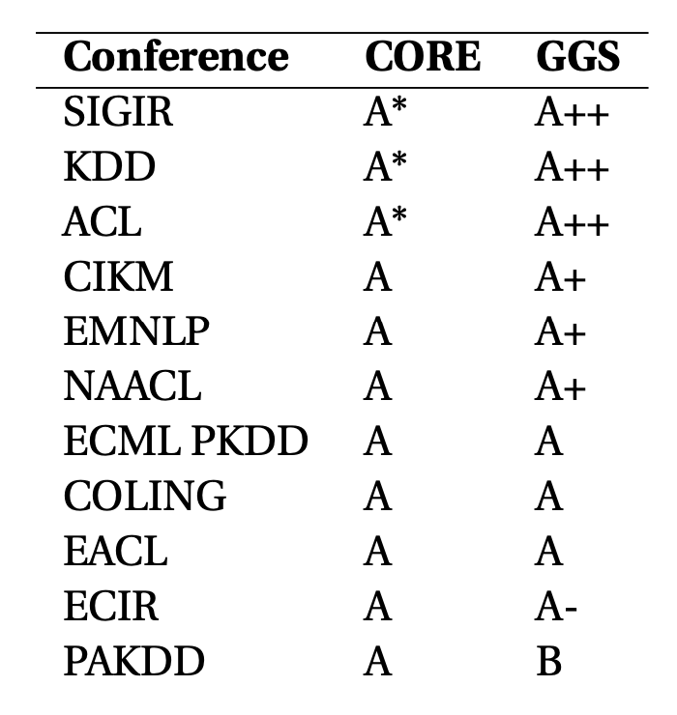
Venue selection process
From the selected query:
A first set of candidate venues is identified based on the number of associated documents.
Cut-off values set at:
30 articles for journals
20 articles for conferences
Results:
23 candidate journals
11 candidate conferences

Slide 6
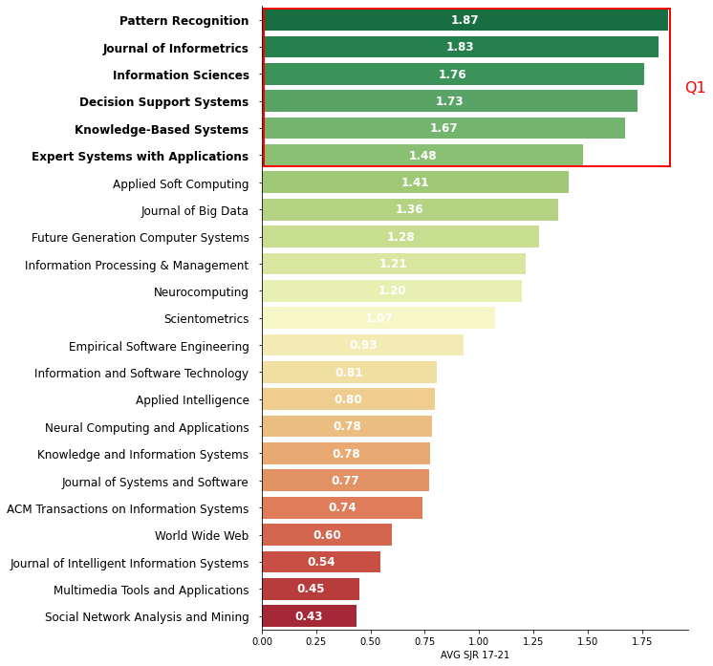
Venue selection process
Candidates are filtered based on values tied to selected quality metrics:
Scimago Journal & Country Rank (SJR(2)) score
Computing Research and Education Association of Australasia (CORE) rankings
GII-GRIN-SCIE (GGS) rankings
Final venues are obtained by retaining:
25% of best scoring journals
All conferences with an “A” rating
(Final) Results:
6 journals
10 conferences

Slide 7
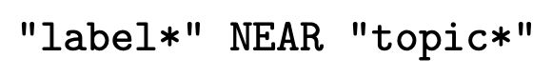
Search strategy
Query used in the venue selection is refined by means of a proximity operator:
…and used to gather the primary studies
Proximity constraint is set to 20 terms
“The average length of sentences in scientific writing is only about 12-17 words” - Griffies et al. (2013)
Examples of captured sentences:
”Topics can be more readily interpretable when they are assigned semantically meaningful labels” - Hosseiny Marani et al., 2022
“Various methods have been proposed to assign concise labels to topics to improve interpretability” - Zosa et al., 2022
“An interpretable topic is one that can be easily labeled. How easily a topic could be labeled . . .” - Doogan and Buntine, 2021
Notes:
Mention why the query is split in two parts

Slide 8
(Initial) Study selection
An initial set of 937 documents is collected
Using the proximity constraint, 424 primary studies are kept
201 conference and 223 journal papers
Inclusion\exclusion criteria are applied by means of manual inspection
Only studies actively applying topic labeling techniques are kept
Secondary & tertiary studies are filtered out
A core selection of 55 papers is obtained
Represents the first set of studies included in the Review
Is used as a starting point for the snowballing activities

Slide 9

Snowballing activities
Core collection is used to extend the scope of the review by extracting:
References (backward snowballing)
Citations (forward snowballing)
This additional work is filtered via the query used for the initial collection
…and the inclusion/exclusion criteria
B.S.
Initial collection
F.S.
References
Citations
738
55
1147
160
58
23
358

Slide 10
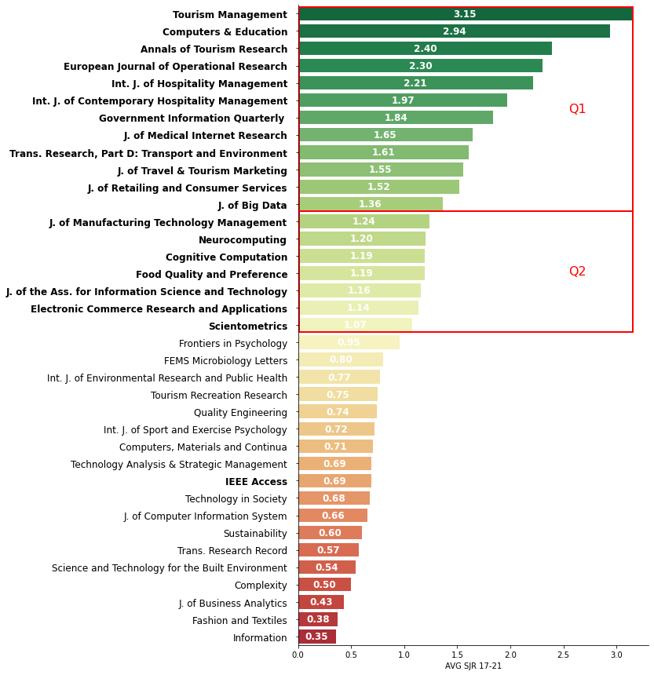
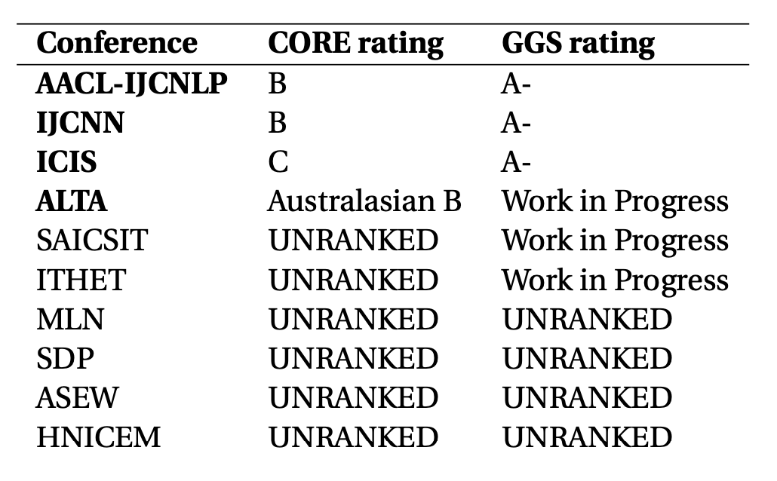
Snowballing activities
Quality of the snowballing studies is also taken into account
For B.S., properties of the core collection are expected to carry over to the referenced work
For F.S., no a-priori assumption of quality can be made for the gathered citations
Solution Exploit the metrics used in the venue selecion process
SJR(2) score for journals
Avg score of 1 and above
…and one cherrypicked venue (IEEE Access)
CORE/GGS ranking for conferences
Additionally, a check for predatory venues is performed
Notes:
19 journals (and 24 studies)
+1 additional journal (2 studies)
4 conferences (4 studies)

Slide 11
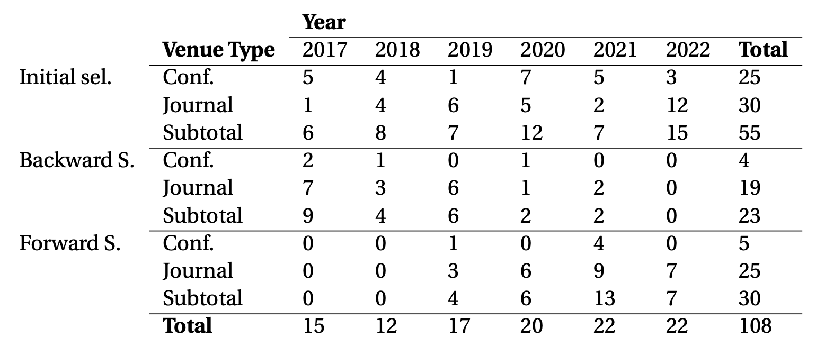
(Final) Study selection
A selection of 108 papers is obtained
B.S.
Initial collection
F.S.
References
Citations
23
55
30

Slide 12
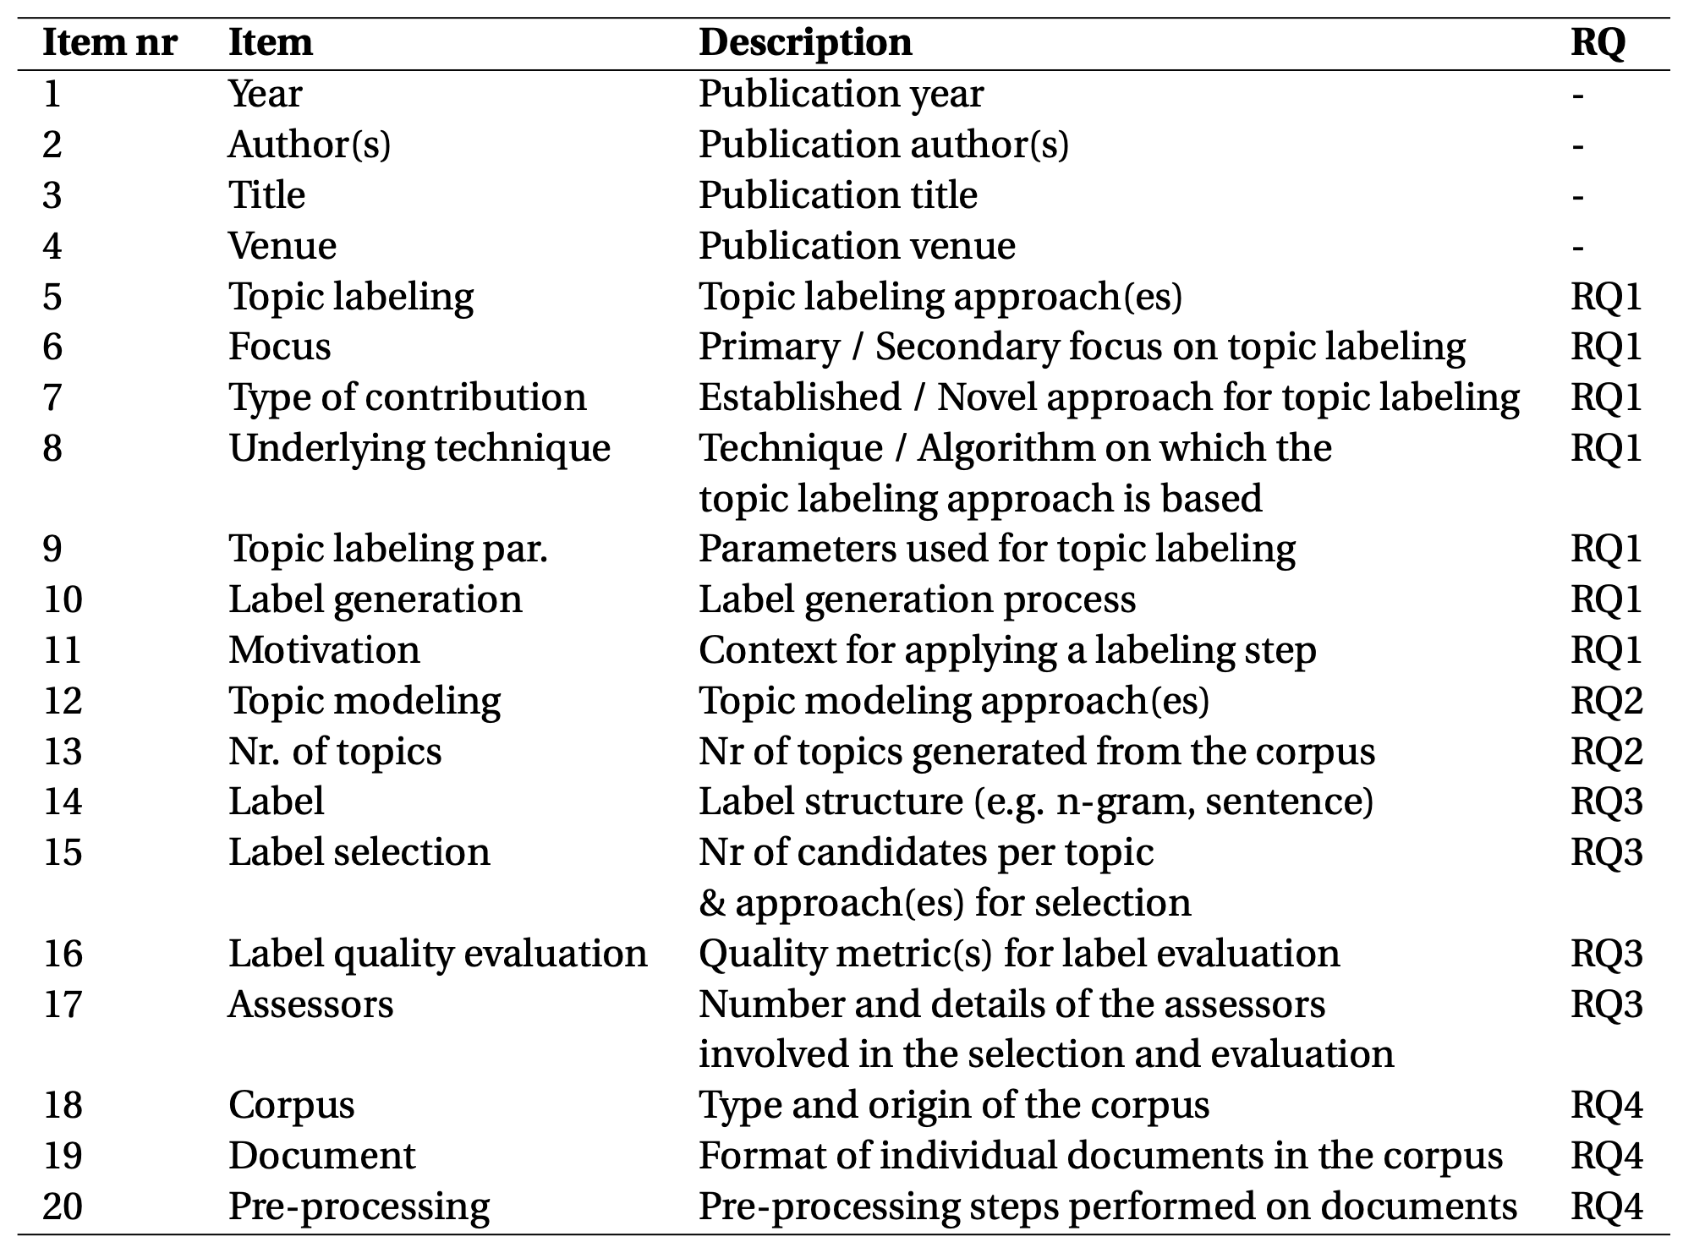
Data items
Data collection is centered around data extraction forms
Establish which information is relevant for the review (what to look for in primary studies)
Made up of 20 data items
Ties each group of items to a specific RQ
(with the exception of items 1-4)
A version of this form is manually populated for each of the included (108) papers

Slide 13
Structure of the analysis and synthesis
Collected data is analysed in order to provide:
A synthesis of the evidence found in the primary studies
Conducted following the defined data items
Drawing comparisons between the encountered methodologies, contents and findings
Ultimately used to address the posed research questions
A description of the identified research gaps
Highlighting what is missing or otherwise lackluster
Selected insights from individual studies
Identified on the basis of the accessibility of the documents…
… and the reproducibility of the described methodologies
Offered to provide guidance to prospective researchers

Slide 14
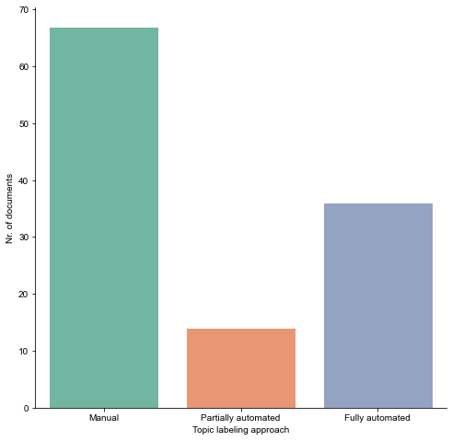
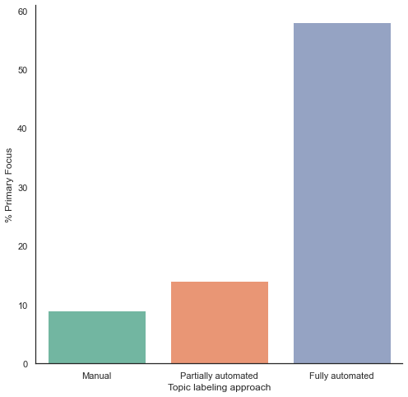
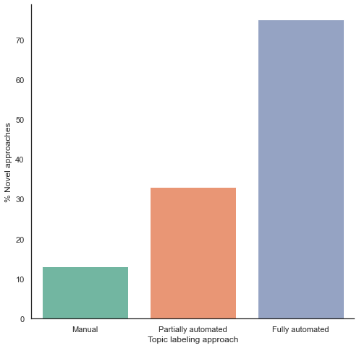
RQ1 – Topic labeling approaches
Categories of manual, partially automated and fully automated approaches are identified
And further profiled by observing
The focus of the associated research with regards to topic labeling
The novelty of the proposed approaches
With regards to (1), it is found that
Most studies show a secondary focus on topic labeling
Primary focus grows as one moves from manual to automated approaches
Similar insights are found for (2)
Established approaches are generally favoured
The same trend is shown for the growth in the use of novel approaches
Notes:
Primary focus -> Mention of labeling in title/abstract/introduction
Most studies show a secondary focus on topic labeling -> 75% -> Expected given the application of the query to the entire body
Non-novel approaches are favoured in most studies -> 64% -> Manual labeling is also not considered novel (in most cases)

Slide 15
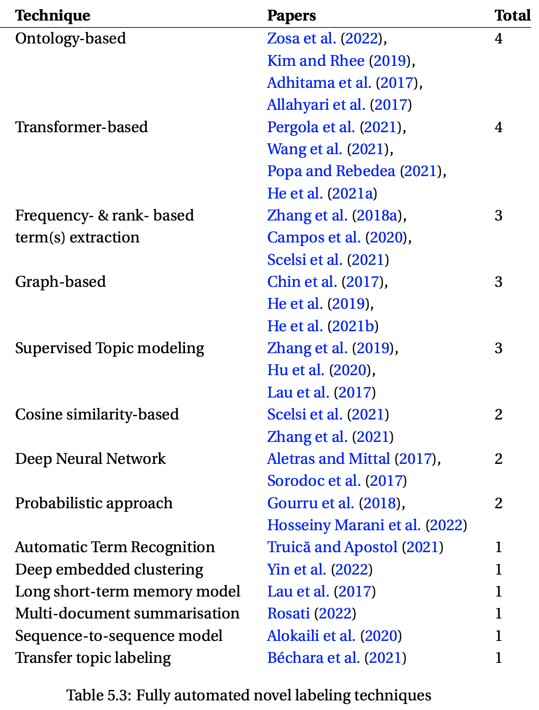
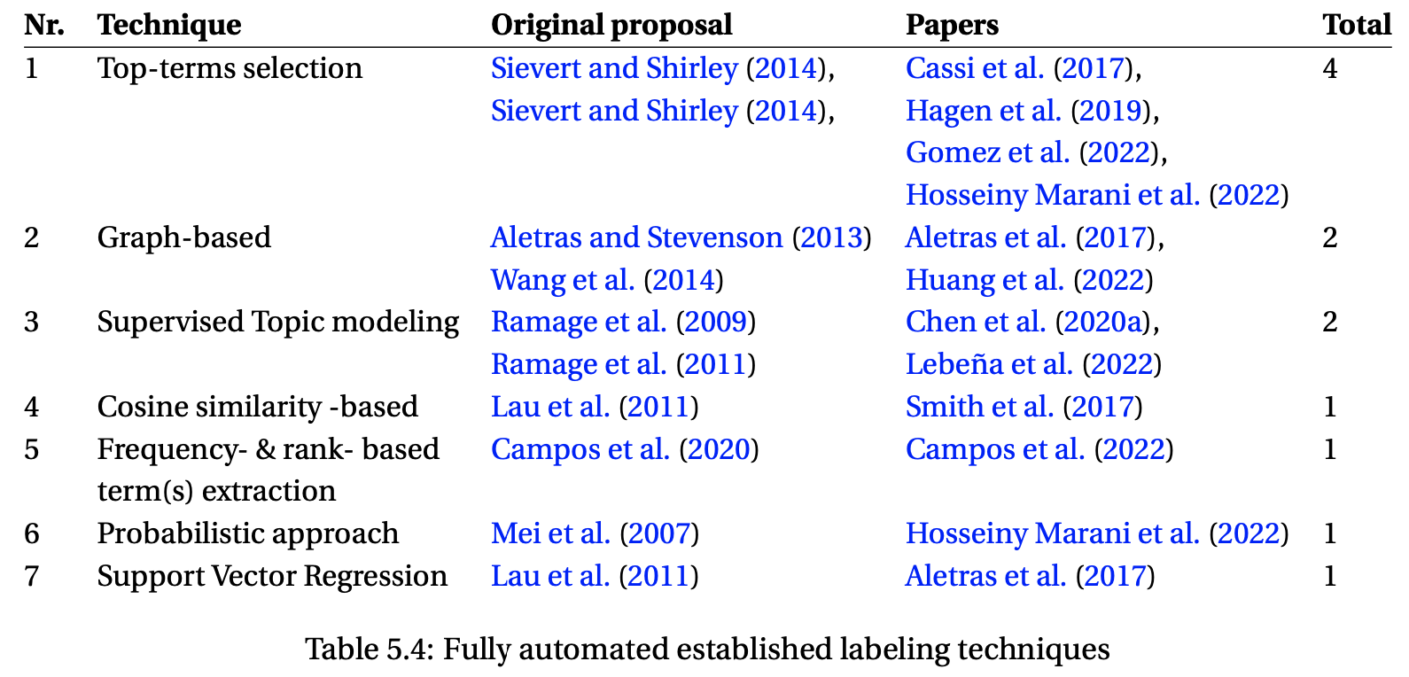
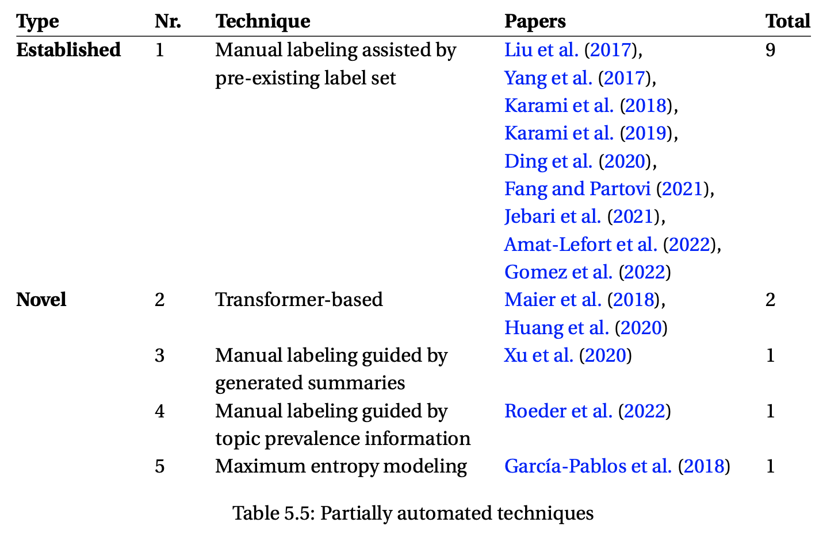
RQ1 – Labeling techniques & Motivational context
Underlying techniques characterising the three macro-categories are explored
Fully automated approaches are the most varied (implemented by 16 categories of techniques)
Followed by partially automated ones
Finally, only two techniques are found among manual labeling approaches
Motivating factors for employing labeling steps are also extracted
Providing a better characterisation of the analysed corpus
Producing more easily interpretable topics
Addressing the overhead of manual labeling
Assessing the interpretability of the generated distributions

Slide 16
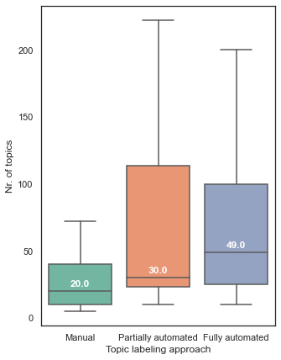
RQ2 – Topic modeling & Nr of generated topics
Topics are generated by means of 16 modeling methods
As expected, LDA (and LDA-based) techniques are generally common across all labeling categories
Solely for manual approaches, STM is also found to be fairly common
Distributions tied to the number of topics tied to the three labeling approaches suggests that:
Partially and fully automated approaches seems to create favourable conditions for generating more topics
Observations for manual approaches are more tightly clustered around the median value
Notes:
STM is capable of incorporating document metadata (e.g. authors, publisher, date, etc.) into the generative process
documents making use of STM are found in the 86% of cases to be interested in “Characterising the corpus”
-
authors employing manual labeling might be less willing to experiment with the generation of an higher number of topics given the inherent bottleneck that such a manual approach would imply during the labeling phase

Slide 17
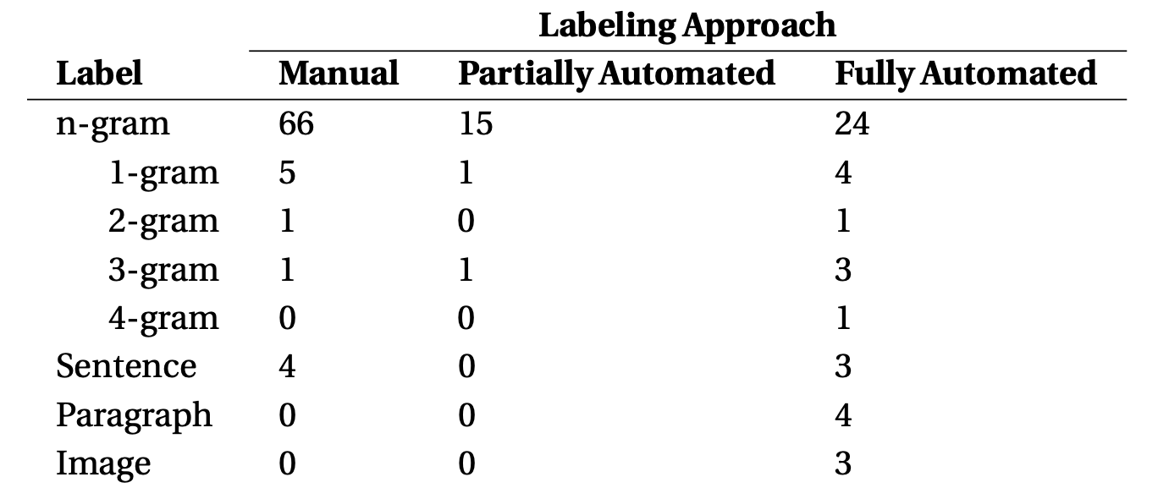
RQ3 – Label structures
A total of 4 distinct structures (i.e. label types) are observed
As expected, most studies employ phrase labels (some with fixed sizes)
The majority of “alternative” representations are found in papers utilising fully automated approaches
Notes:
Notice that one document can potentially have more than one label type

Slide 18
RQ3 – Candidate selection & quality evaluation
Label selections from candidates sets are a relatively rare occurrence
Observed in less than 10% of studies
Always conducted by human assessors
Label quality evaluation is more common (found in ~20% of studies)
Human-based approaches
Four-level scales of relevance (“totally irrelevant” – “perfectly fitting”)
Binary evaluations (“unrelated” – “good”)
…
Automated approaches
Transformer-based (BERTScores)
Cosine similarity
…
, and divided among:
Notes:
Majority voting, Common agreement, Joint labeling
Quality = Ability to effectively describe the topic
-
BERTSCORES, Cosine between generated and gold-standard or topic terms
Rogue1 = Overlap metric between label and terms

Slide 19
RQ4 – Categories of corpora

Slide 20
Research gap 1 -

Slide 21
Thank you

Slide 22
Additional Slides

Slide 23
Summary of methodological contributions

Slide 24
SLRs vs SMSs

Slide 25
SEGRESS

Slide 26
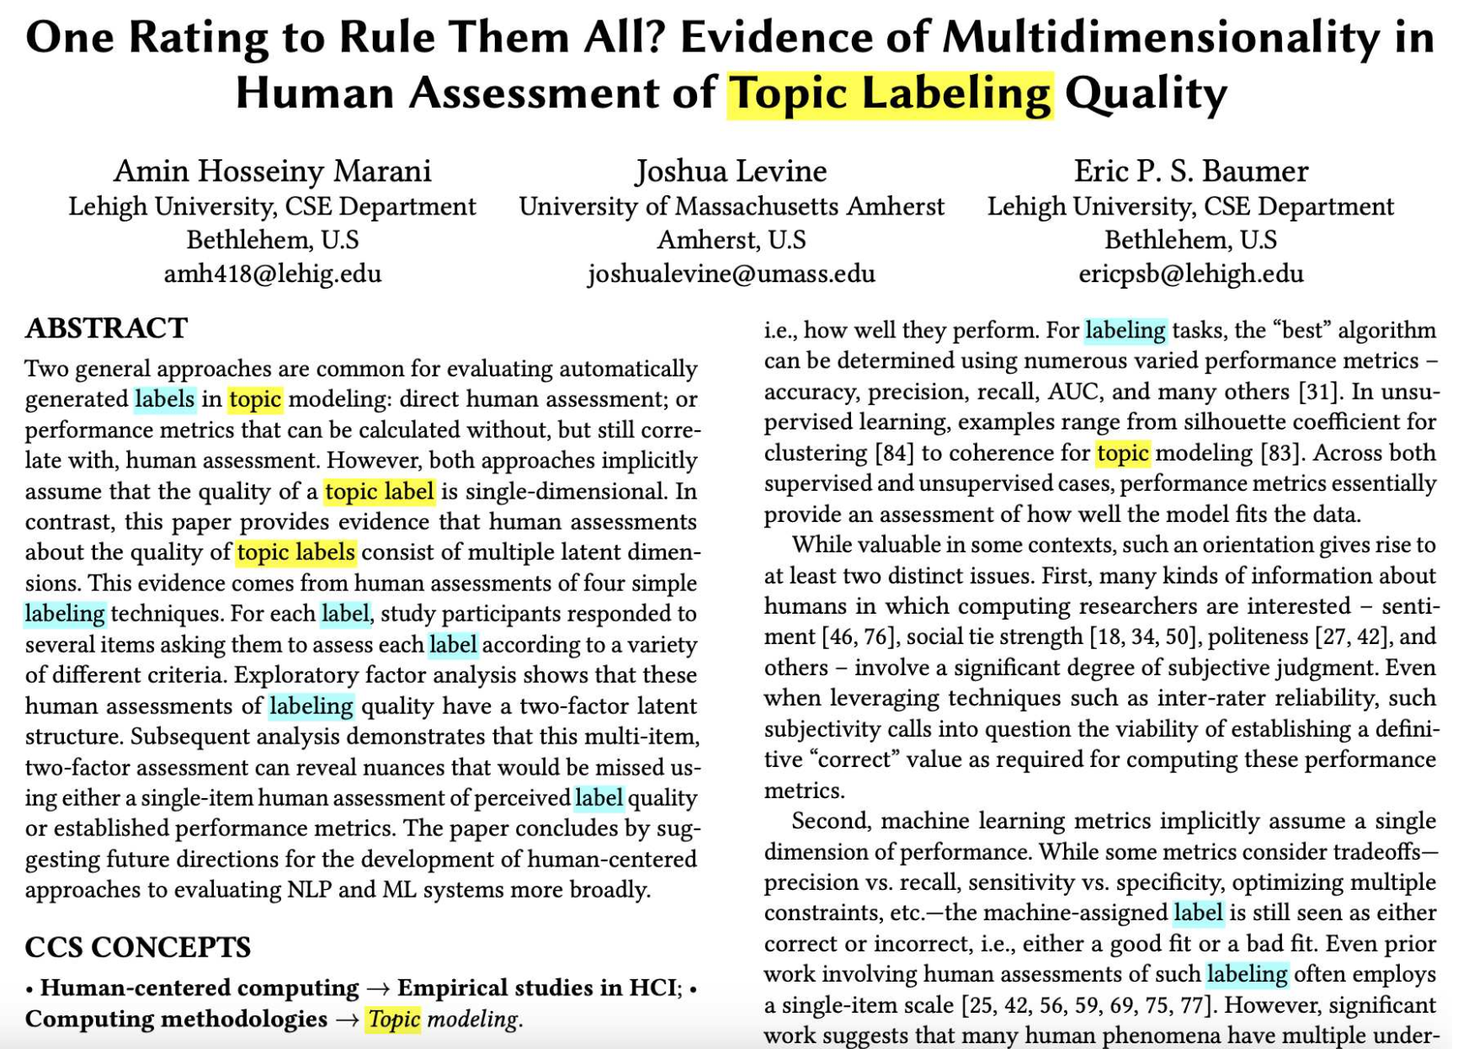
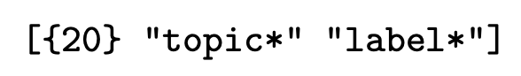
Data collection process

Slide 27
Guidelines for identifying gaps

Slide 28
Future work - Literature networks

